Slide 1

Presentation On
Ratings Prediction Project
Presented by
Aamina Ruvaida

Slide 2


Slide 3
Agenda
Overview
Problem Statement
Problem Understanding
Importance of Rating Prediction
Data Analysis
Exploratory Data Analysis
Visualization
Model Building
Hyper Parameter Tuning
Conclusion

Slide 4

Overview
In this Ratings Prediction Project we will looking into
How to analyse the dataset
What are the EDA Steps used in cleaning the dataset
Visualization of Ratings
Overall Analysis of Problem
Data Pre-processing
Balancing the target variable
Model Building from the Cleaned data
Saving the Final model.

Slide 5
Problem Statement
We have a client who has a website where people write different reviews for technical products. Now they are adding a new feature to their website i.e. The reviewer will have to add stars(rating) as well with the review. The rating is out 5 stars and it only has 5 options available 1 star, 2 stars, 3 stars, 4 stars, 5 stars. Now they want to predict ratings for the reviews which were written in the past and they don’t have a rating. So, we have to build an application which can predict the rating by seeing the review.

Slide 6
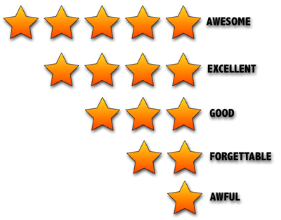
Problem Understanding
The user feedback information based Collaborative Filtering algorithm is often used to discover the hidden preferences of users and potential features of items in Recommender System for the past few years. Nevertheless, the potential relationship between different users is often ignored in the current Collaborative Filtering algorithm which contained in the user feedback information. The study indicates that user reviews and ratings will directly affect the sales of the product. Customer before buying check the reviews of that product and decide whether to buy it or not.

Slide 7
Importance of Ratings Prediction
Rating prediction is an important technology in the personalized recommendation field. Prediction results are influenced by many factors, such as time, and their accuracy directly affects the quality of the recommendation.
In order to predict review rating considering the features embedded in the reviews. Sentiment of review considered one of the most valuable features that could be utilized to properly solve the task at hand better. Doing so would lead to more reliable ratings prediction and assist users to make the right options.

Slide 8

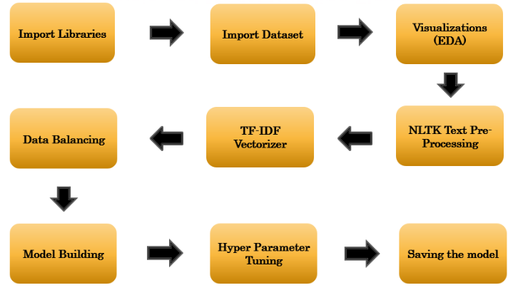

Model Building Flow Chart

Slide 9
Exploratory Data Analysis
Importing necessary libraries and loading the dataset.
Checking the shape of data, unique value, statistical summary of data, count of data etc.
Checking the null value and replace the missing value with mode. Removed the column Unnamed: 0 from the dataset.
Visualized the ratings using the seaborn and matplotlib libraries.
We have done the text data pre-processing, removed the stop words, punctuation, character and words splitting into different column and check the count of words and character. Using the Stemming and Lemmatizer.
We have converted the text into vector using the TF-IDF Vectorizer. Vectors can be put as input and used in the training and testing the model.
Balanced the target variable ratings using the Over sampling technique SMOTE.

Slide 10
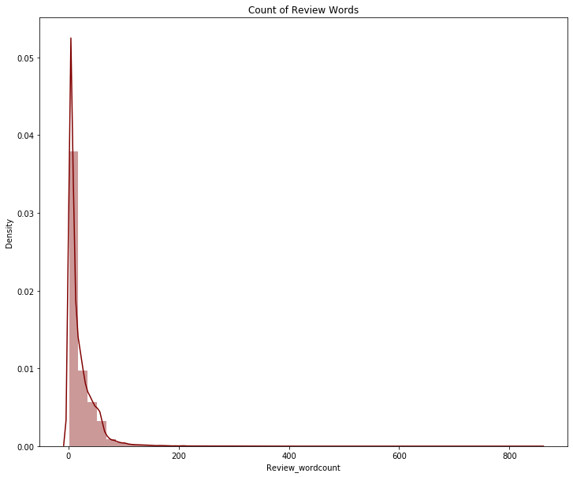
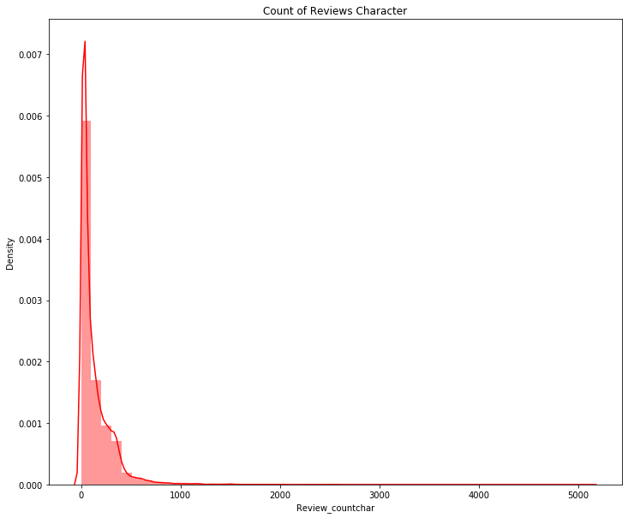
Visualization
In the above distribution plot the word count lies in the range 0-200 and character count lies in the range 0-1000. Most of the reviews range is length that can act as an outliers in the dataset.

Slide 11
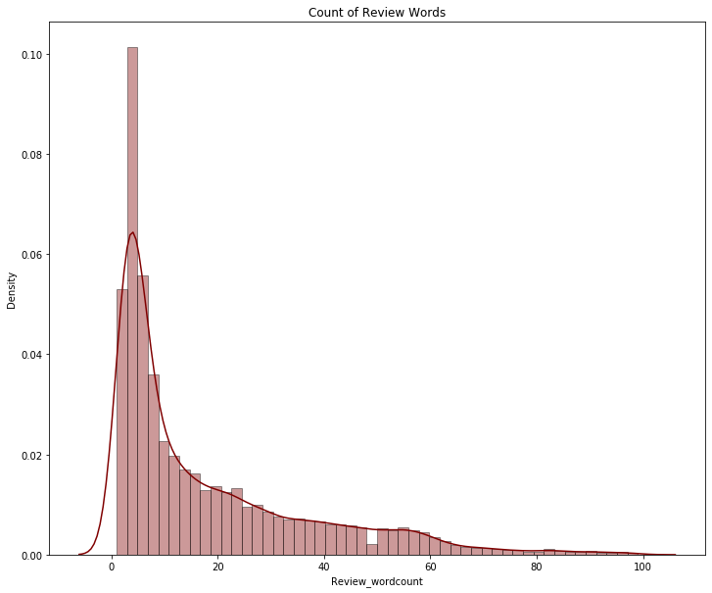

After removing the Outliers
After removing the outliers we see that the count of word lies in the range 0-100 and count of character lies in the range 0-800. The lengthy tail has removed using the zscore method.

Slide 12
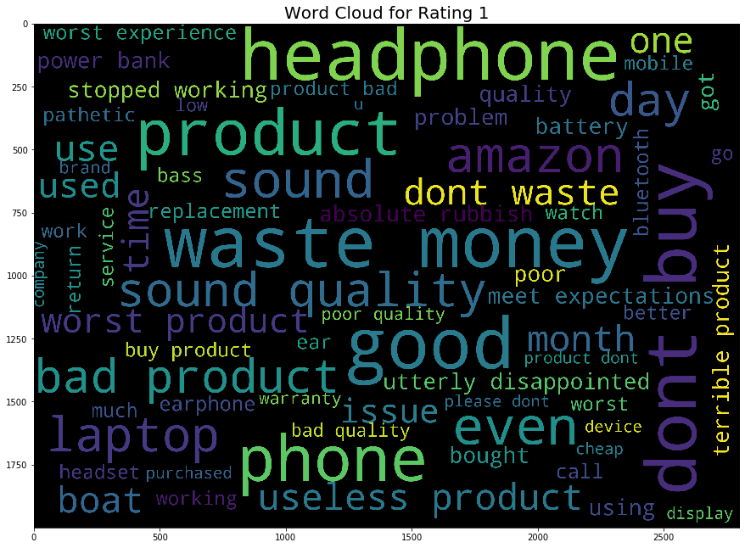
Visualization of Word Cloud

Slide 13
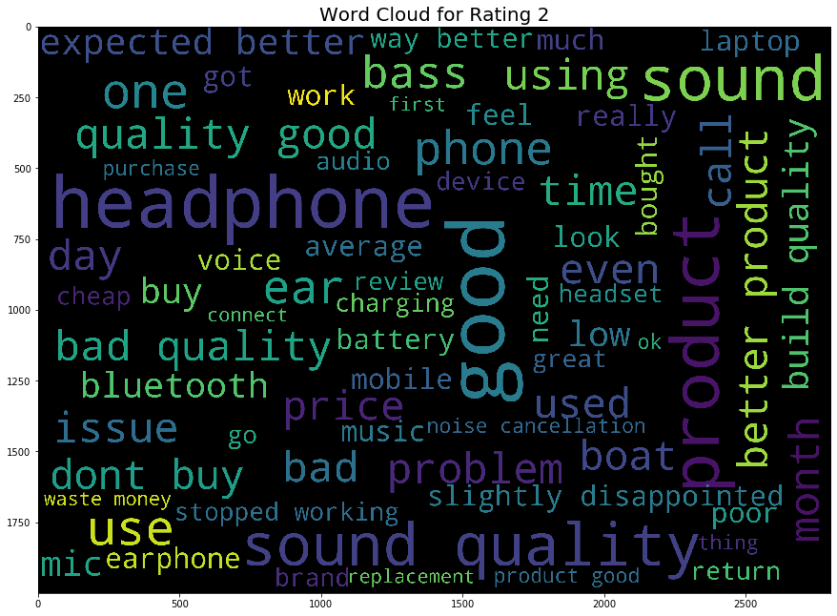
Visualization of Word Cloud

Slide 14
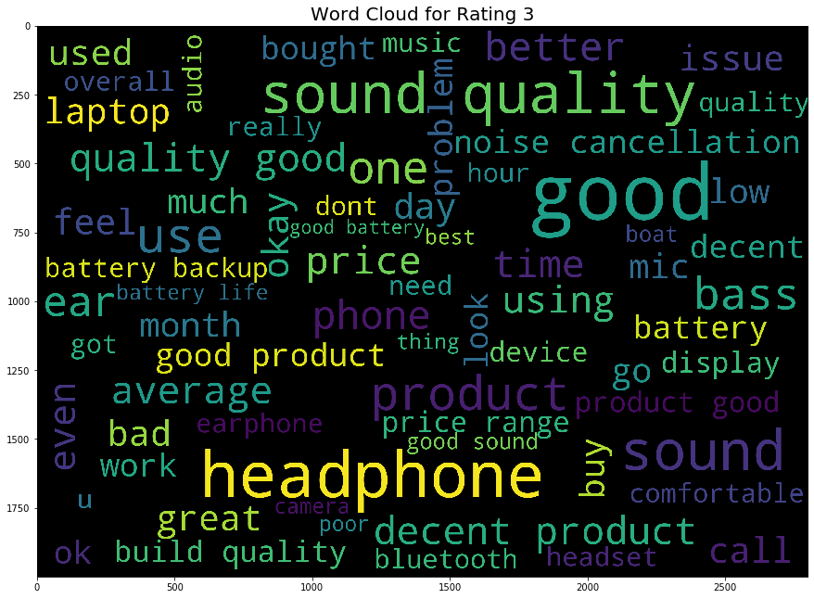
Visualization of Word Cloud

Slide 15
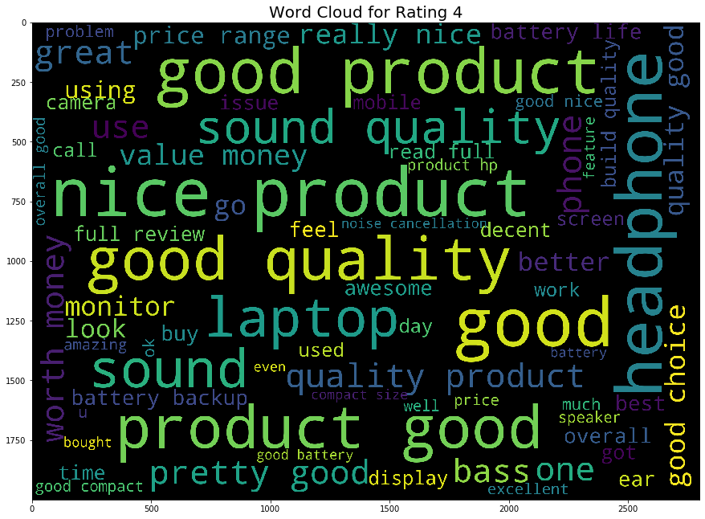
Visualization of Word Cloud

Slide 16
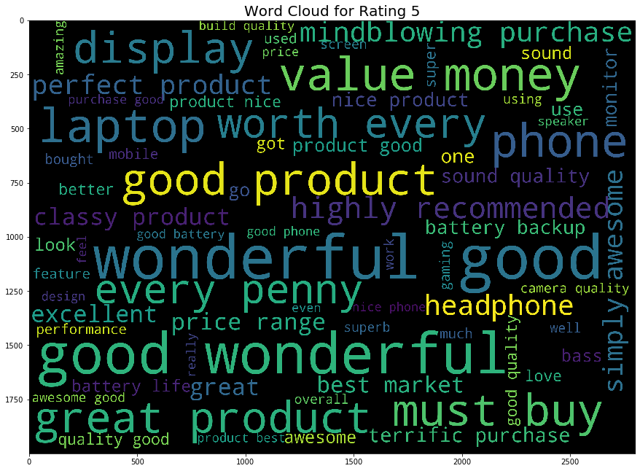
Visualization of Word Cloud

Slide 17

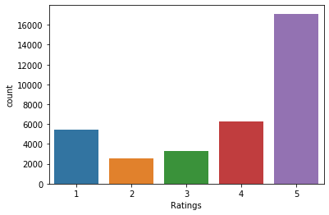
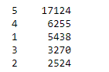
Count of Ratings
Majority of people rated 5 ratings. In the above count plot it shows the highest count in 5 ratings. Customer who have satisfied with the product has given the 5 ratings.

Slide 18
Observation
In this project the main purpose is to explore the data, feature engineering and classification. As the data is huge we can explore it more deeply by analysis the data set. In the review it contains lots of stop words, punctuation, short words. Removed those from the review to make it simple and more accuracy.
Using the TF-IDF Vectorizer I have converted the text data into vector. That can be used as input for building the model. We have used word cloud to visualize the frequently used words..
Removed the symbols, url from review using the regular expression.
As the dataset contains the outliers, we have removed the outliers using the zscore method.
Balanced the data using the oversampling technique SMOTE.
Finally we have build the machine learning model to train and test the data.

Slide 19
Model Building
In this NLP project converted the text into vector using the TFIDF Vectorizer. Then I have splitted into x and y. X is feature variable and Y is target variable. Hence it is multi classifier problem. I have build various model to train and test the data. I have chosen Random Forest Classifier as my final model. As it performed well as compare to other models. Below the machine learning model used in the project.
Decision Tree Classifier
Random Forest Classifier
Ada Boost Classifier
Gradient Boosting Classifier
Logistic Regression
Multinomial NB
XGB Classifier
SGD Classifier

Slide 20
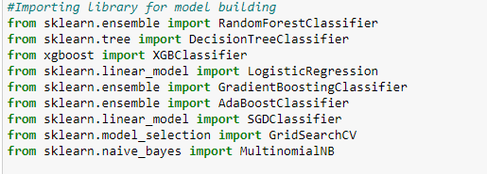
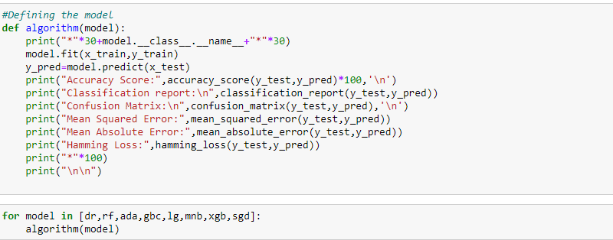
Importing the ML Libraries
Defining the Function to run all ML Model

Slide 21
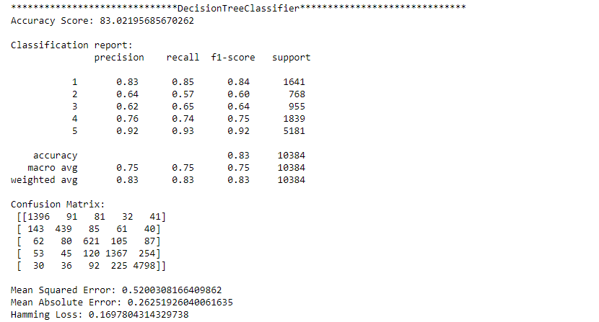
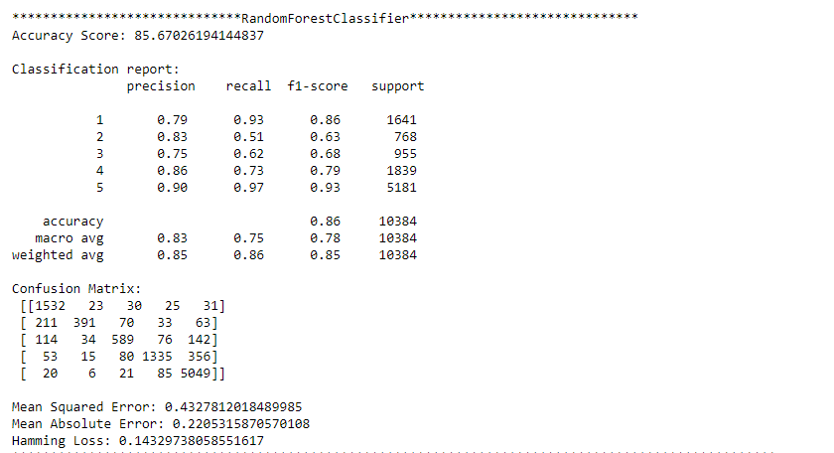
Decision Tree Classifier
Random Forest Classifier
In the above model we see that Decision Tree Classifier gives the accuracy 83% and Random Forest Classifier gives the accuracy 86%. Also we see the classification report, confusion matrix, mean squared error, mean absolute error, hamming loss for the model.

Slide 22
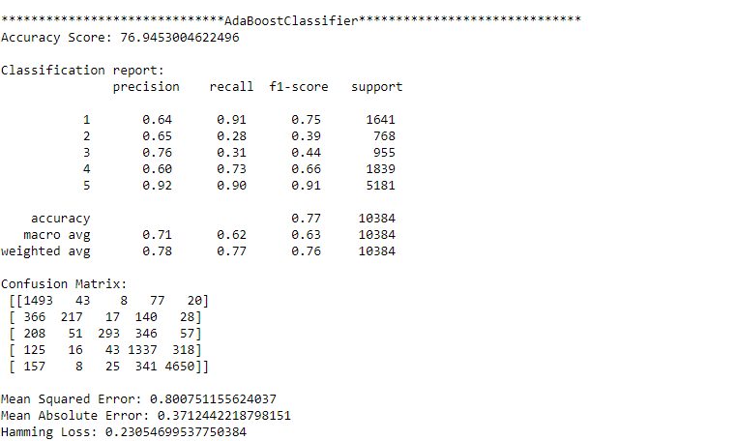
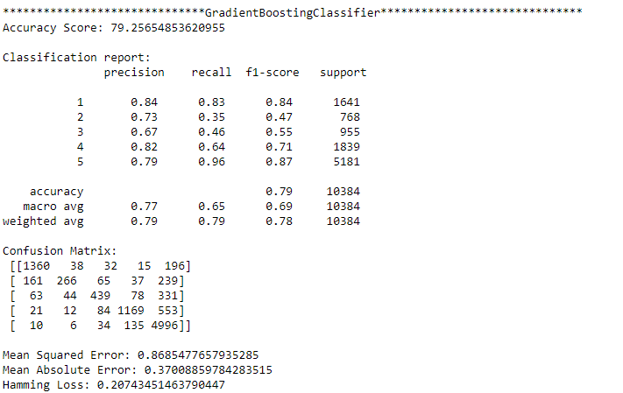
Ada Boost Classifier
Gradient Boosting Classifier
In the above model we see that Ada Boost Classifier gives the accuracy 77% and Gradient Boosting Classifier gives the accuracy 79%. Also we see the classification report, confusion matrix, mean squared error, mean absolute error, hamming loss for the model.

Slide 23
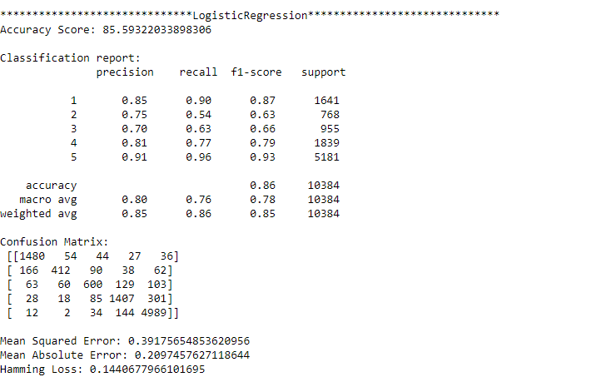
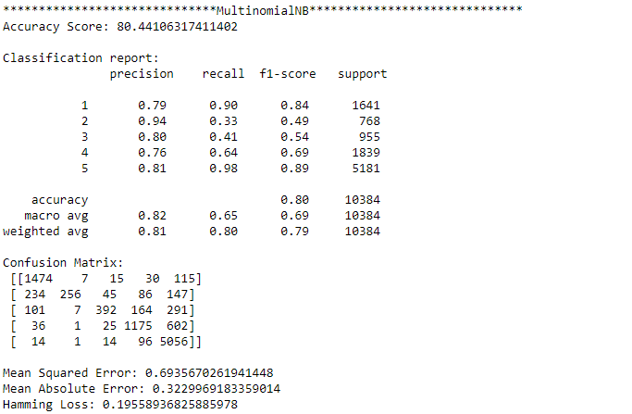
Logistic Regression
Multinomial NB
In the above model we see that Logistic Regression gives the accuracy 86% and Multinomial NB gives the accuracy 80%. Also we see the classification report, confusion matrix, mean squared error, mean absolute error, hamming loss for the model.

Slide 24
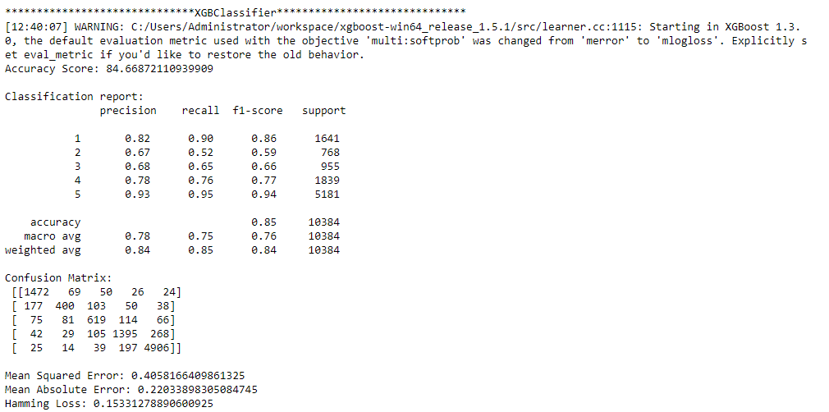
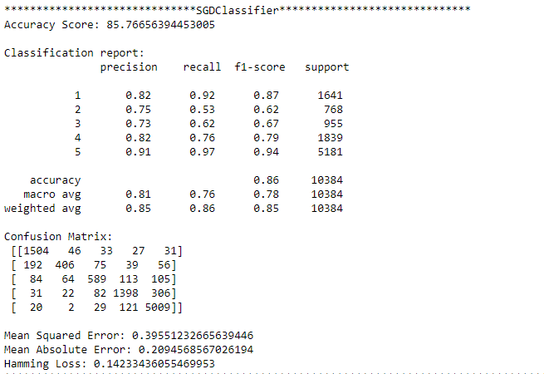
XGB Classifier
SGD Classifier
In the above model we see that XGB Classifier gives the accuracy 85% and SGD Classifier gives the accuracy 86%. Also we see the classification report, confusion matrix, mean squared error, mean absolute error, hamming loss for the model.

Slide 25
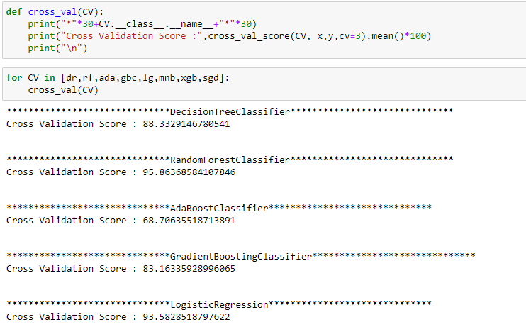
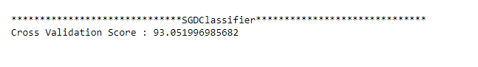
Cross Validation Score
Random Forest Classifier gives a good cross validation score and also gives a good accuracy. So, I will consider Random Forest Classifier as my final model

Slide 26
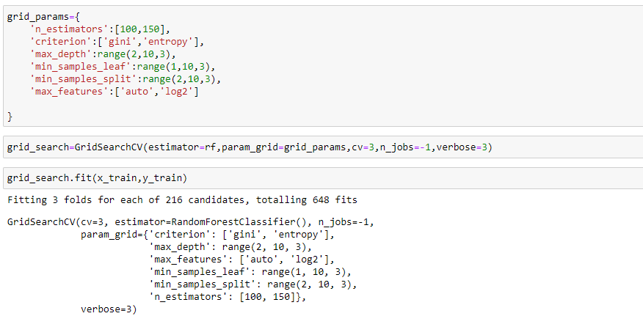
Hyper Parameter Tuning

Slide 27
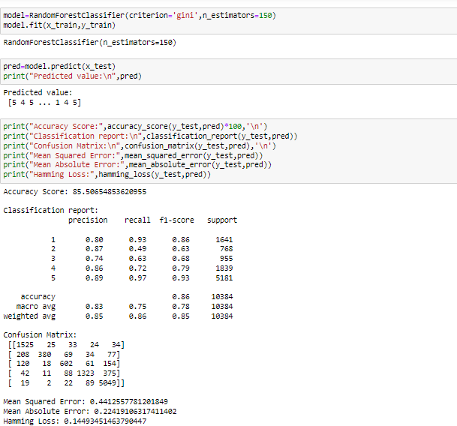
Training the Final Model
After the tuning our model, we got the accuracy 86%. Saved the model using the pickle.

Slide 28
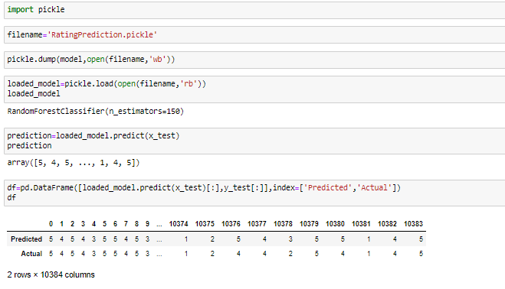
Saving the Final Model
Saved the model using the pickle and predicted the ratings for the reviews.

Slide 29
Conclusion
In this project I have used a NLP Machine learning algorithm to predict the Rating Prediction. We have analyse the model using the visualization tool using the count plot, distribution plot, heatmap, word cloud.
Removed the stop words, punctuations, URL, unnecessary words from Reviews. Data cleaning is the most important steps in any machine learning model. We have cleaned the data by removing the outliers using the zscore method.
We have converted the text into vector using the TFIDF Vectorizer. Balanced the data using the over sampling technique SMOTE.
We have splitted the data into feature(x) and target(y) variable. Then we have trained and test the data by giving the 70% of data for training and 30% of data for testing. We have used various machine learning model and compare other model. Choose the best model which performed well and gives a good accuracy. We have done the cross validation score for all our models. In this project Random Forest Classifier gives a good accuracy and it performed well.
Then we have done the hyper parameter tuning to check if we can increase our accuracy further.
Finally we have saved the model using the pickle and predicted the ratings. The predicted and actual value almost gives the same output. Our model has performed well.
With this prediction it helps the customer to choose the product wisely and also help to grow the business to understand the customers likes and dislike. What customer needs from Product. Based on that business can focus on those area to give a better customer service.

Slide 30


